Slide 1
Section 2.6
Acceleration from a Velocity-Time Graph

Slide 2
Another Method
Aside from using formulas to calculate acceleration, we can get information from a V-T graph
If the V-T line is straight on the origin, velocity is 0 and acceleration is 0
Any horizontal V-T line indicates constant velocity and acceleration is 0
If the V-T line is a diagonal line, acceleration is constant and has a horizontal line equal to the slope of the V-T line

Slide 3
Using Slope
The slope of the lines on V-T graphs give the acceleration at the moment in time (instantaneous acceleration)

Slide 4
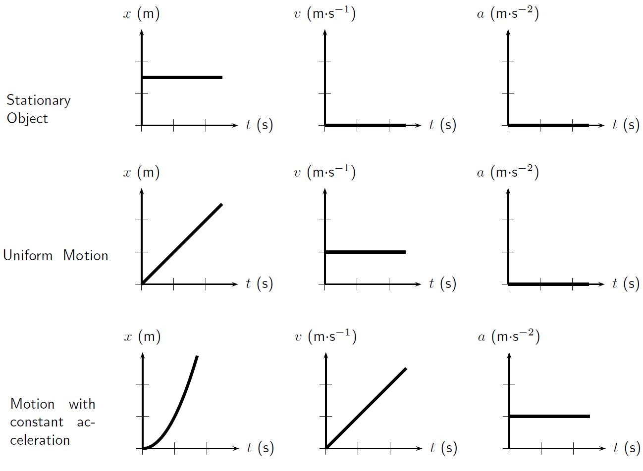
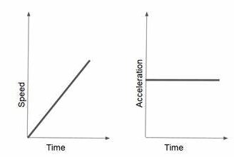

Slide 5
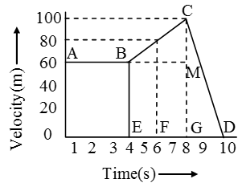
Example
Find instantaneous acceleration:
(i) at t = 3s
(ii) at t = 6s
(iii) at t = 9s
Solution:
(i) Instantaneous acceleration at t = 3s is the slope of line AB = zero
(ii) Instantaneous acceleration at t = 6 s is the slope of line BC= +10 m/s²
(iii) Instantaneous acceleration at t = 9 s is the slope of line CD = -50 m/s²

Slide 6
Finding Velocity from A-T Graph
The area under the A-T graph gives the change in the velocity of the object in the given interval of the time.
The area under curve = △v
Just like we find distance from the area under a V-T graph (think rectangles and triangles!)

Slide 7
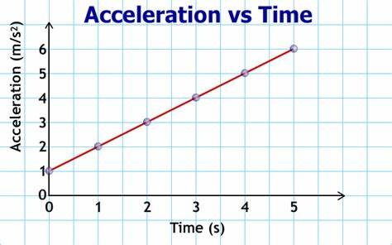
Example
Find the change in velocity of the object from 2 to 3 seconds

Slide 8
Solution
Triangle: ½ bh = ½ (1)(1) = 0.5 m/s
Rectangle: l x w= 3x1 = 3 m/s
Change in velocity= 3.5 m/s

